Slide 1
Database Backups

Slide 2
What are Database Backups?
A backup is a copy of data that is used to restore and recover data after a system failure.
Fact: Servers crash and sometimes SQL Server fails.
How can we avoid loss of data and recover SQL Server as soon as possible?
  By creating a backup of a database, the database structure and its data are backed up to a file(s).
  We can then use the backup to restore our database to a certain point in time.
  Database administrators usually schedule backups to be at created at regular intervals.
Backup files have the file extension .BAK

Slide 3
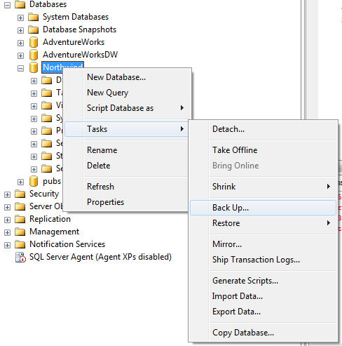
Using Management Studio
Creating a Backup: aka “A Dump”

Slide 4
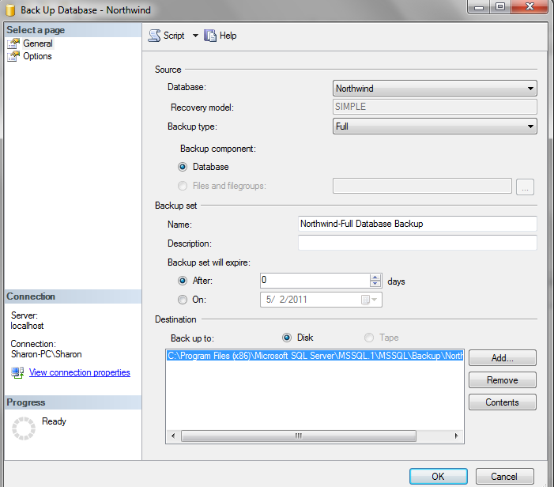
Back Up Database Options
There are many items that can be configured for a backup.

Slide 5
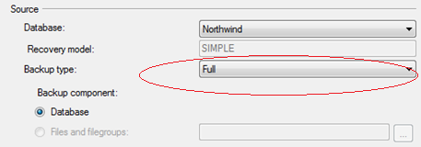
Backup Type
There exist 3 types of backups that you can choose from
  Full
    Full backup of your actual database file as it is as of the last transaction that was committed.
  Differential
    “backup since” backup
    Writes out a copy of the extents that have changed since you did the last full backup.
    Runs faster than a full backup and takes up less space
  Transaction Log
    Writes out a copy of the transaction log

Slide 6
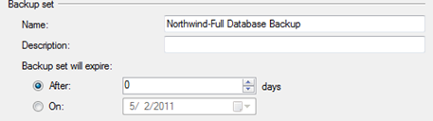
Backup set
The Backup Set property is basically a single name used to refer to one or more destinations for your backup.
Since backups can be large, sometimes backups are spread across multiple files. A backup set links them together as a unit.

Slide 7
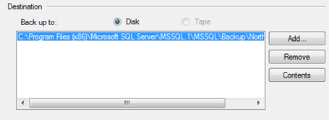
Destination
The Destination is where your data is going to be backed up to
  Sometimes there are several destinations
  For most installations, this will be a file location
    Usually copied to tape later
    Consider that the entire server may crash (which include your backup files). You need to plan for this and copy them elsewhere.

Slide 8
Using T-SQL instead of Management Studio
Note that there are several options that can only be issued using the T-SQL commands instead of using the Management tools.
A simple T-SQL command for a full database backup looks like
  BACKUP DATABASE Northwind
  TO DISK=‘C:\Backups\Northwind.BAK’
  More examples of how to construct T-SQL commands for each type of backup are in the “simple talk” article included in this week’s lesson.

Slide 9
Recovery Models
Recall that SQL Server uses a transaction log.
  This log is used to deal with transaction rollback, but is also critical to being able to recover data up to the point of the system failure.
For certain businesses, it is not acceptable to be able to recover only from last full backup – no data can be lost.
  Consider a bank and the amount of transactions that take place.
If the database backup and the transaction logs are available, you should be able to recover right up to the point of failure.
The recovery model chosen determines how long and what type of log records are kept.
  There are 3 types of recovery models: Full, Bulk-Logged, and Simple.

Slide 10
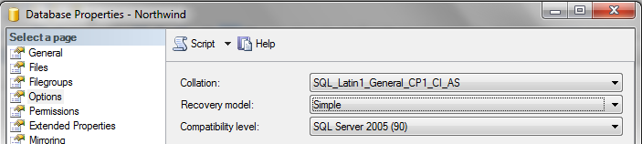
Recovery Models (cont’d)
Where can the recovery model type be specified?
In Management Studio, this is under the Database Properties
Using T-SQL, the syntax looks like:
  ALTER DATABASE Northwind SET RECOVERY SIMPLE

Slide 11
Full Recovery Model
In this model everything is logged
No data loss in the event of system failure assuming you have a backup of the data and all transaction logs since that backup
Full recovery can take up a lot of space
Full recovery is what is primarily used in production

Slide 12
Bulk-Logged Recovery Model
This is like “full recovery light”
Regular transactions are logged just as they are with the full recovery, but bulk operations are not
Given system failure, a restored backup will contain any changes to data pages that did not participate in bulk operations.

Slide 13
Simple Recovery Model
Transaction log is not used in the recovery, only the database file is backed up
Smaller log with better performance
Some data loss can occur

Slide 14
Recovery Models and Backup Types
How does this topic of “Recovery Models” relate to the different “Backup Types”?
Once a model is chosen, you still need to configure the backup as appropriate.
  Recall this is under Tasks->BackUp…
The “Transaction Log” backup type will only appear if you have chosen to use the Full or Bulk-Logged model.

Slide 15
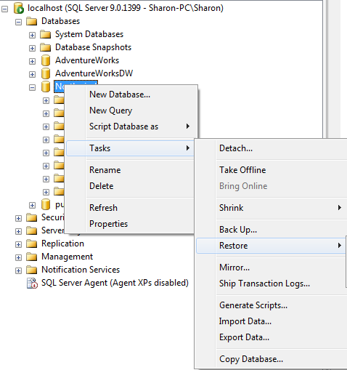
Recovery
Recovery is the process of restoring your database from a backup file(s).
Note that you can use to recover a damaged/lost database OR to make a copy of your database elsewhere
  Consider you could backup your database and copy it to a test server using the backup/restore options.
To restore a database in Management Studio:
Right click database, Tasks->Restore

Slide 16
Recovery using T-SQL
As always, you can choose to use T-SQL commands instead of using Management Studio’s GUI tools.
An example restore statement:
  RESTORE DATABASE Northwind
  FROM DISK = ‘C:\Backups\Northwind.BAK’

